Slide 1
CS 0447 Recitation 12

Slide 2
Last Week’s Quiz
Q1
A: Jumps set the PC to a new value, while branches add an offset to the PC or do nothing
Q2
A: Von Neumann has one memory and uses multiple clock cycles to execute each instruction; Harvard has two memories and uses one clock cycle to execute each instruction
Notes:
Q1: We say that jumps are absolute instructions, while branches are relative. What is the difference?
Q2: What is the difference between a Von Neumann Architecture and a Harvard Architecture?

Slide 3
Last Week’s Quiz
Q3
A: Instructions that access memory
Memory is MUCH slower than the CPU, so accessing memory is the slowest type of operation.
Q4
A: The path that has the longest series of sequential operations
Notes:
Q3: What types of instructions cause single-cycle CPUs to be so slow?
Q4: What is the critical path of a circuit?

Slide 4
No Quiz This Week!
Yay!

Slide 5
Multicycle CPU Overview
Single cycle CPUs are slow
Some instructions take much longer than others, thus slowing down the clock speed we can use
Solution: chop up instructions and have them take multiple clock cycles
Remember that instructions have different phases of execution
We can break instructions into pieces based on these phases

Slide 6
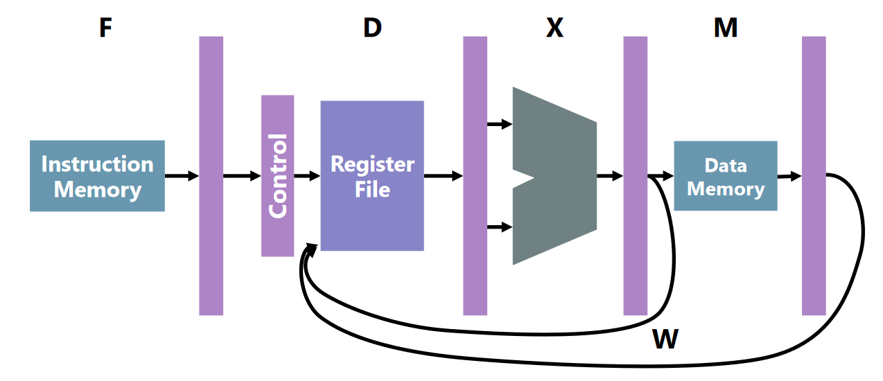
Multicycle Datapath
Each phase of execution has its own “unit”
Between units, we insert registers to save data for the next phase

Slide 7
CPI and IPC
CPI – cycles per instruction
This is the measure of how many cycles the average instruction takes to compute
IPC – instructions per cycle
The reciprocal of CPI

Slide 8
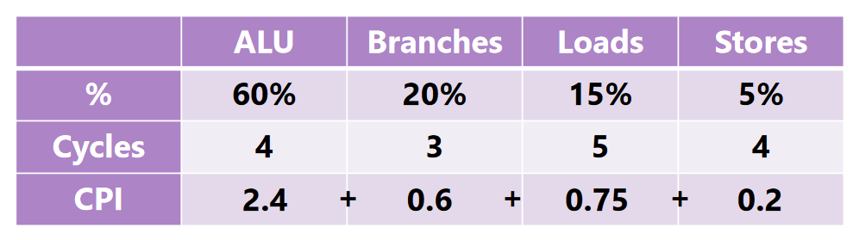
CPI and IPC
Calculating CPI
It is different for each program
Each instruction falls into a category – ALU, branch, load, etc.
Multiply the percentage of instructions in a category by the number of cycles for that category and sum up
Performance equation: if we have n instructions, it takes n *CPI * time per cycle seconds to execute the program

Slide 9
Multicycle Summary
Single cycle CPU aren’t very fast and the slowest instructions hold the other ones back
Solution: make instructions take multiple clock cycles to execute
This will give us a performance boost over a single cycle CPU

Slide 10
Finite State Machines
A finite state machine (FSM) is a model of computation
They are useful for problems where we have
A series of inputs
We need output(s)
The state stores some information
The input can change the current state and the output
You will discuss these at length in 1502

Slide 11
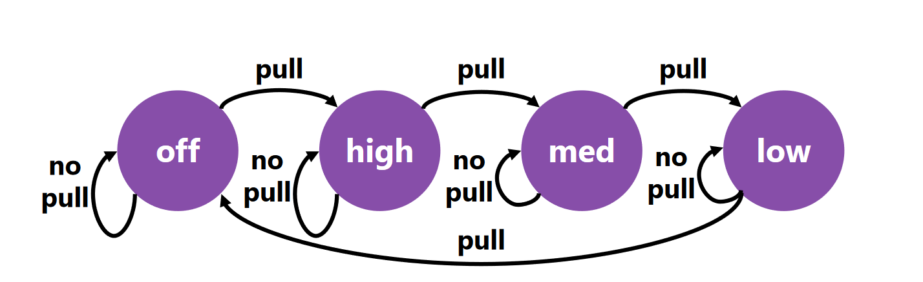
FSM Example
A simple example: a ceiling fan
Whenever you pull the cord, you change the state of the fan
The state we move to depends on
The current state
The input

Slide 12
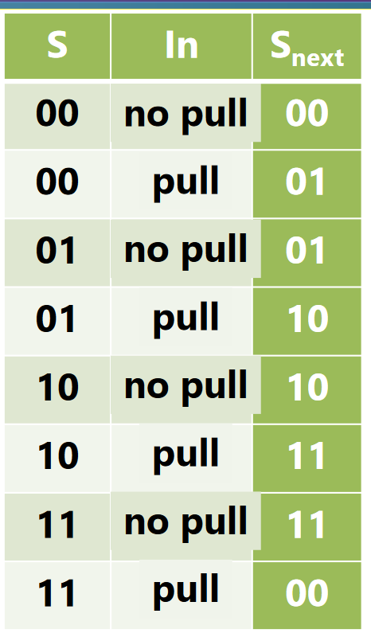
FSM Diagram to Table
We can encode that state diagram into a table
In the left column we have the states, in the middle we have the inputs, and on the right we have the state to move to
Again, the state we move to depends on
The current state
The input that we see

Slide 13
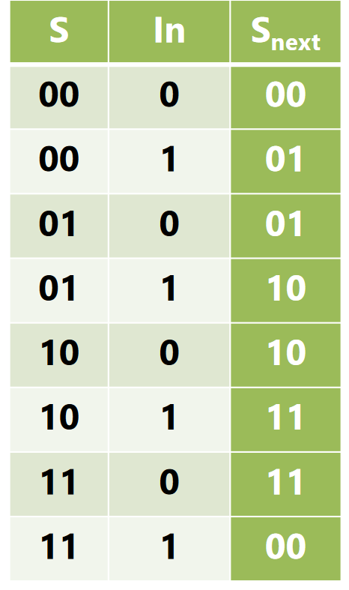
FSMs and Circuits
Let’s encode the inputs from the previous table using 1s and 0s
0 for no pull
1 for pull
This is just any truth table we’ve seen before!
It can be turned into a circuit!

Slide 14
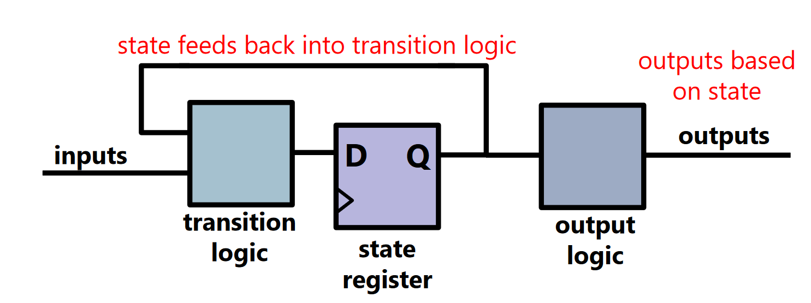
FSMs and Circuits
The current state is stored in the state register
We have transition logic that decides what state we should move to – note that its inputs are the input and the current state!
The output depends only on the current state
We can create the transition and output logic from our truth table!
We could even minimize it with a K-map

Slide 15
Lab 12
Your job is to
Design a state diagram for an FSM
Create the corresponding truth table
Implement the circuit in Logisim
Start with the state diagram
Remember that the next state depends on the input and the current state
Think about what states you might have
For example: having seen no 1s, having seen one 1, etc.

Slide 16
Lab 12
Once you have the state diagram drawn out, creating the truth table is simple
Your table will have the state transitions and outputs for all state-input combinations
Luckily, there’s only two possible inputs: 0 and 1
Once you have the truth table, you can plug it into Logisim to get a circuit

